Slide 1

Computationally Modeling Reasoning
Professor John Licato
University of South Florida
First-order Unification

Slide 2
Limitations of Natural Deduction
Although it seems somewhat close to the “natural” way we reason (i.e. from belief to belief using common patterns of inference between them), it has limitations
Finding a ND proof can be extremely computationally explosive
With FOL, however, there are more tractable algorithms

Slide 3
Strategy 1: Proof finder
Prove: p, q ⊢_{F} r
p, q
p, q, p∧q
p, q, q∨p
p, p∨q, q
…
p, q, q∨p, q∨p∨p
p, q, q∨p, q∨p∨q
…
…
…
…, r

Slide 4
Strategy 2: Refutation finder
Prove: p, q ⊢_{F} r
p, q, ¬r
p, q, ¬r, p∧q
p, q, ¬r, q∨p
p, p∨q, q, ¬r
…
…
…
…
…, ⊥
What is the max tree breadth?
What is the max tree depth?

Slide 5
Remember Resolution?
<< This is called a “resolvent on p”
Let’s see if we can extend this trick to FOL!

Slide 6
Variables vs. terms
Let’s assume, for this lecture, that u,v,x,y,z always refer to variables that are universally quantified
And that a,b,c,… refer to terms (unquantified objects)
Functions always return terms as well
In the next lecture, we’ll show you how to turn any first-order formula into this term
So for what follows, if two separate formulae have the same variable, we can assume they’re referring to the same thing
Let’s just assume we have a list (off screen) that tells us whether a symbol is a variable or term

Slide 7
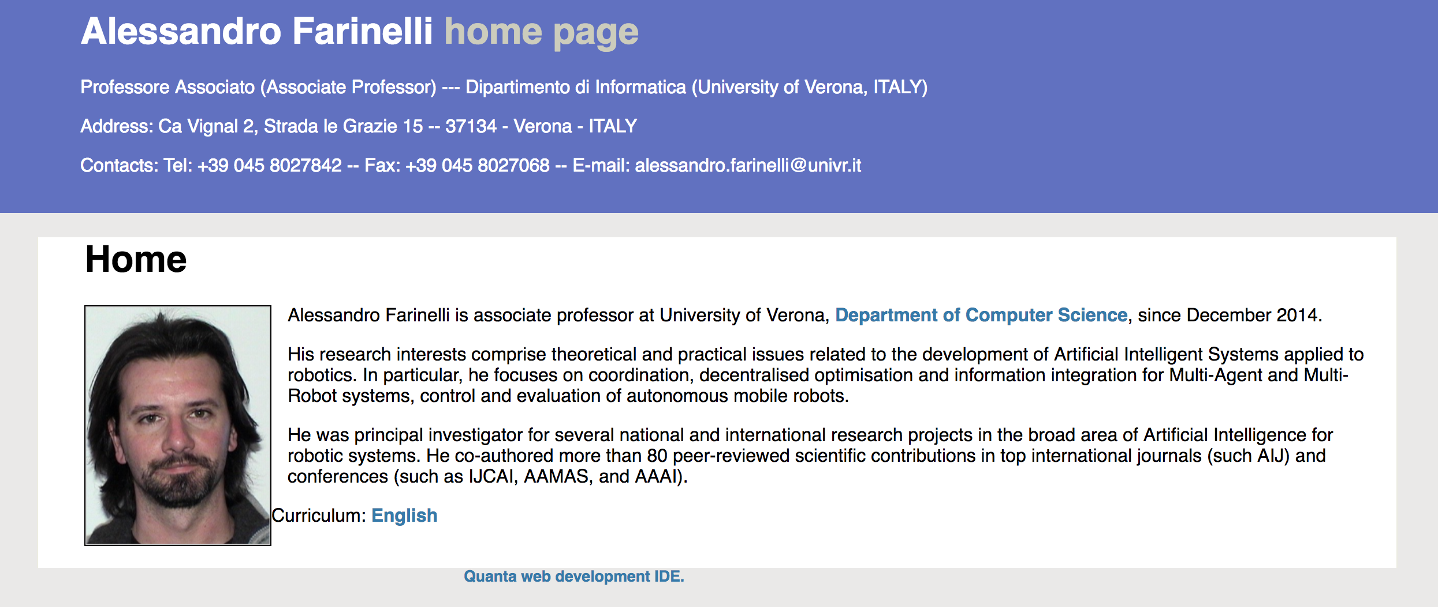
First-Order Unification: The following slides were created by Dr. Alessandro Farinelli

Slide 14
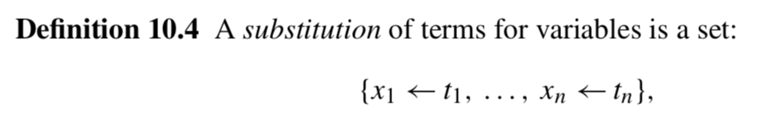
If you want to read:
Chapter 10 in Ben-Ari textbook
But they use slightly different notation for substitutions:
Should be read as “x1 is replaced by t1”
Whereas t1/x1 should be read “t1 replaces x1”

Slide 19
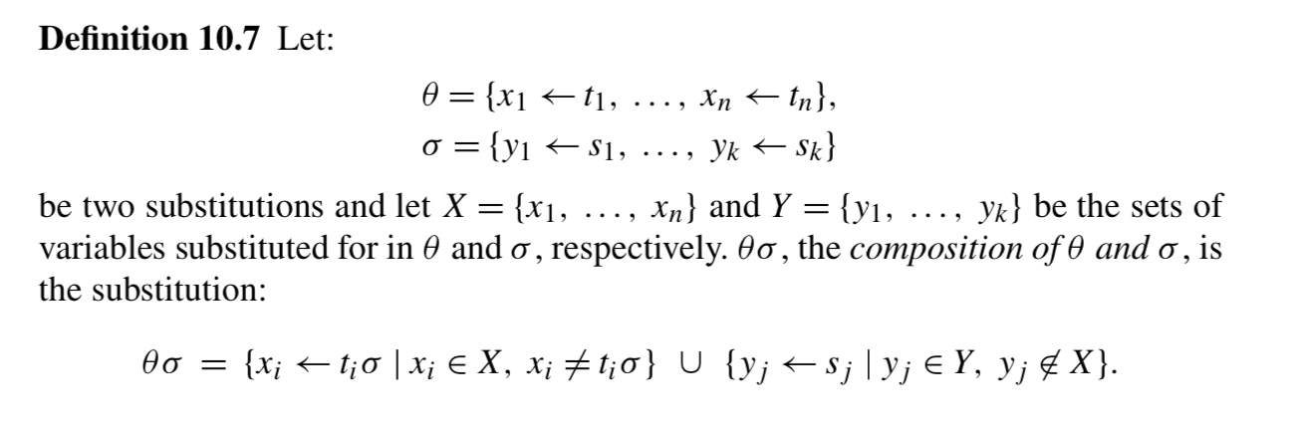
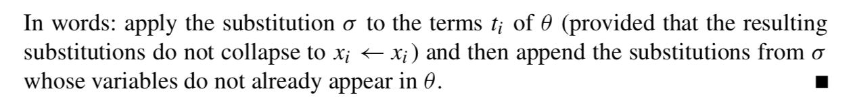

Slide 22
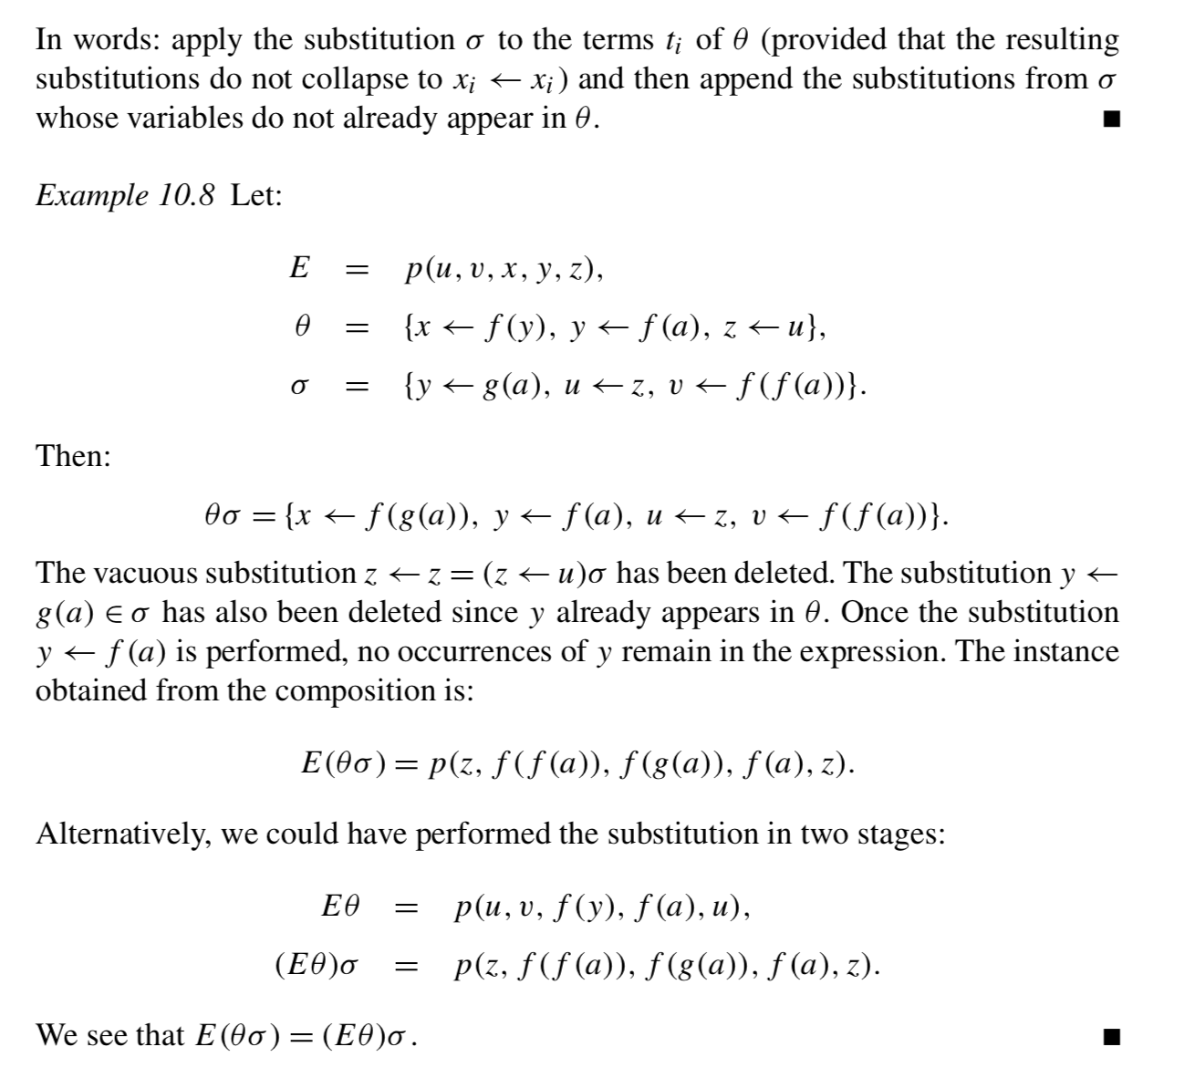

Slide 28
Of course, if two expressions don’t have the same predicate symbol and the same arity, they’re not unifiable, and you can stop there.

Slide 41
